Slide 1
Pacific Tour Enterprises
The South Pacific Islands

Slide 2
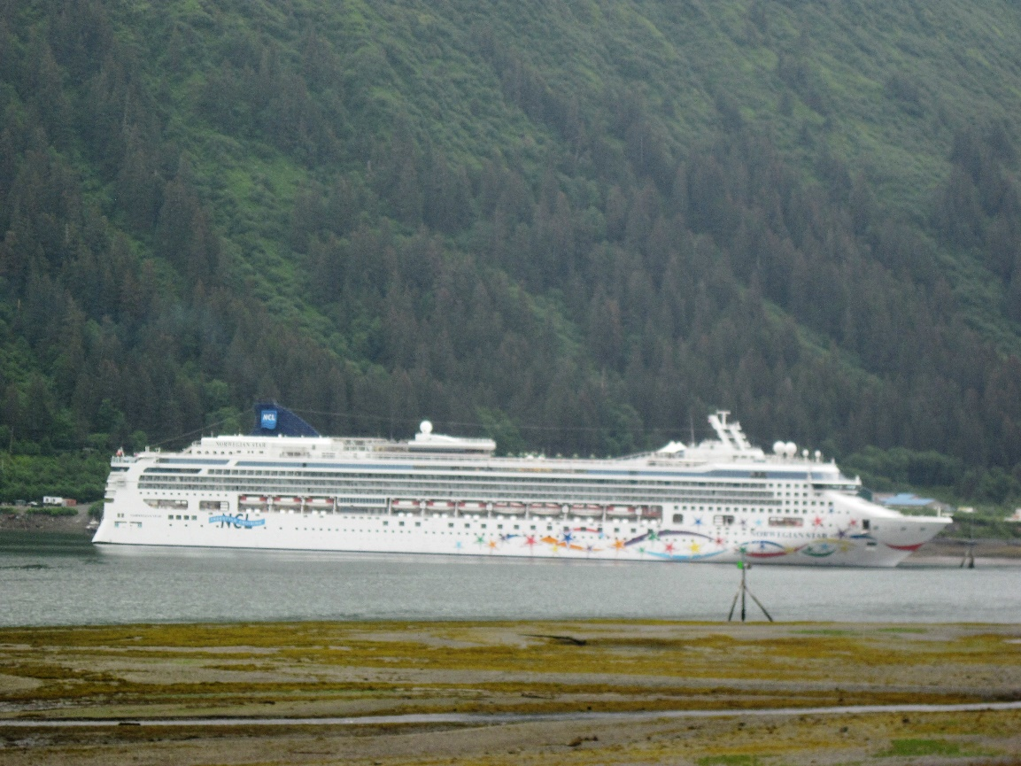
Our Best Tours
Palau Islands
Solomon Islands
Samoa Islands
Society Islands
Indonesia
Philippines
Over 100 different islands to choose from!

Slide 3
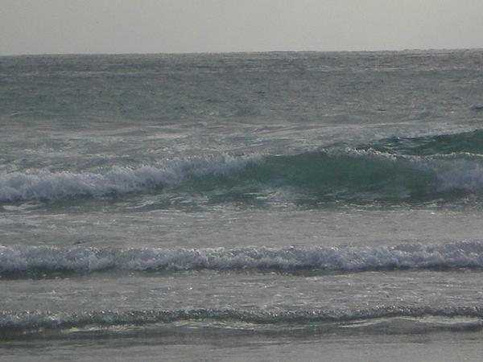
The South Pacific
Beaches
Surfing
Scuba
Fishing
Culture
Cuisine
Notes:
Pacific means peaceful; named by Magellan in 1520.
Largest and deepest of the world’s oceans.
Covers more than one-third of the earth’s surface.
Contains more than 30,000 islands.

Slide 4
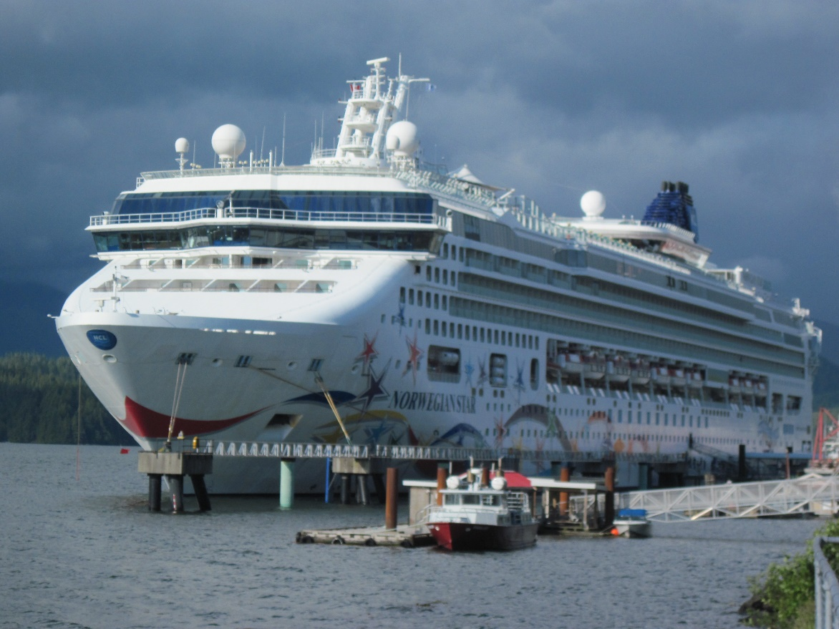
Spring Special
15% off regular price
Bora Bora
Tahiti
Some restrictions apply

Slide 5
Tour List
Tour 1 | Tour 2 | Tour 3 | Tour 4
5 nights | 7 nights | 10 nights | 15 nights
2 Meals | 2 Meals | 2 Meals | 2 Meals
$1,700/ 1 | $1,900/ 1 | $2,200/ 1 | $2,600/ 1
$2,500/ 2 | $2,600/ 2 | $2,900/ 2 | $3,400/ 2

Slide 6
Departing Cities
Los Angeles
San Francisco
Seattle
Denver
Chicago
New York
Miami
*Other US cities
Toronto
Montreal
Vancouver
Ottawa
Winnipeg
Edmonton
*Other Canadian cities
*Add-on airfares applicable

